Slide 1

EXPLAINABLE ML

Slide 2
Why do we need Shap - values?
SHAP - Shapely Additive Explanations
SHAP values are used to explain individual model predictions. For a given prediction, they tell us how each feature has contributed to that prediction or average marginal contribution of an instance of a feature among all possible coalitions.
SHAP value = contribution to prediction
With the help of shap values many machine learning models can be interpreted however it depends on the complexity of the model and the interaction between the features.

Slide 3

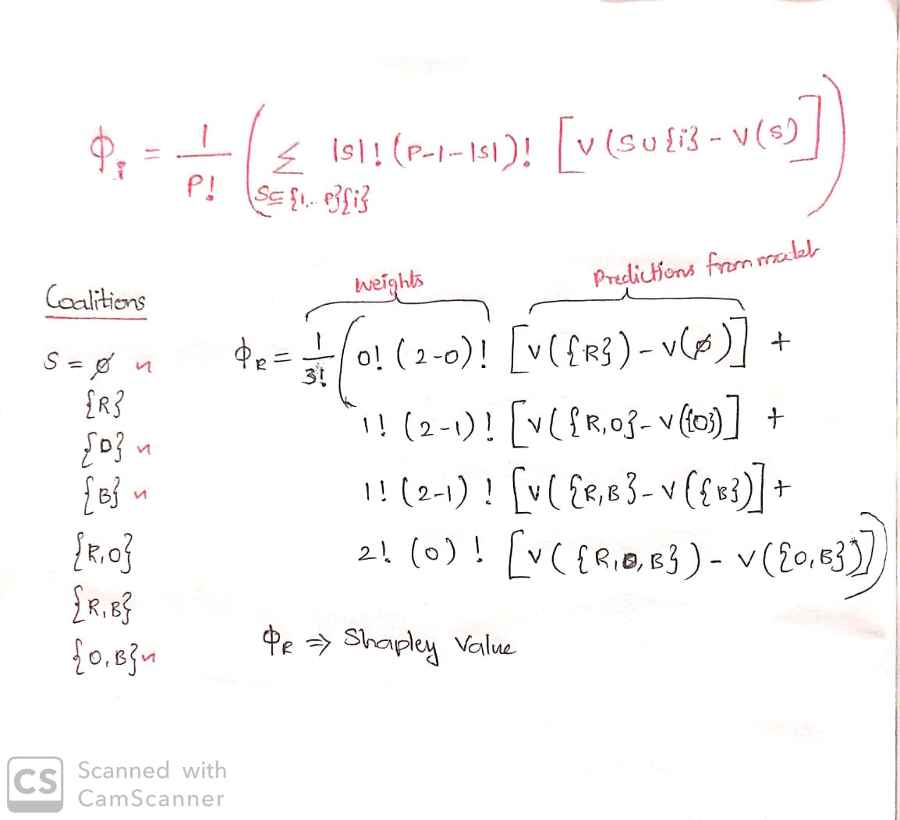
Calculating individual Shap – values (Classical way)
S - No of variables in coalition
I - Variable whose contribution to be found
P – Total number of variables
Instance for calculating shapley value for an observation of a feature(regression):
-
-
-
-
Each color represents a variable

Slide 4
Types of Shap
Tree shap
Kernel shap
Deep shap
Linear shap
Based on the type of model to be interpreted , model specific shap approximations can be used for better reliable values. The computation to find shapley values behind each shap type are different and time to compute differs too.
Kernel Shap: This can be applied to any type of machine learning model, including linear models, decision trees, random forests, gradient boosting models, deep neural networks, and more.
Tree shap: This can be used for tree based models , the computational time is faster compared to kernel shap and the shapley approximation is more reliable for tree based models.

Slide 5
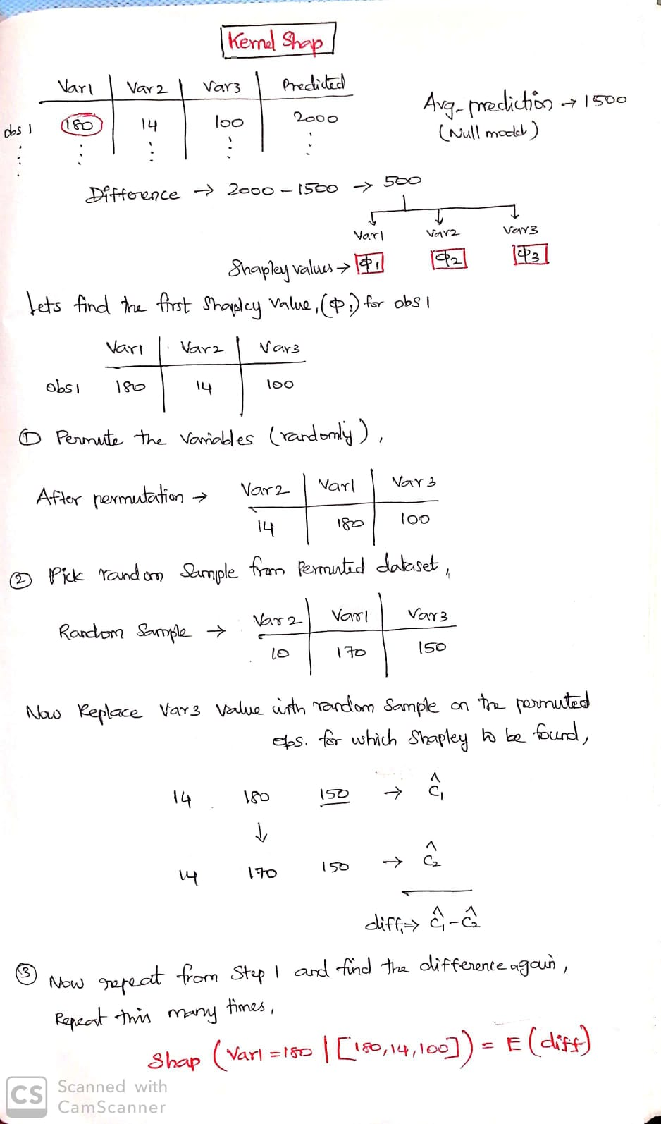
Monte-Carlo Sampling

Slide 6
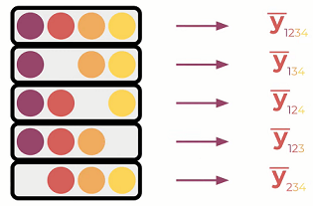
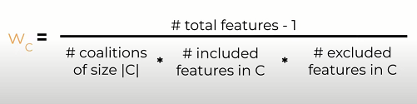
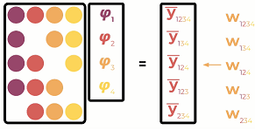
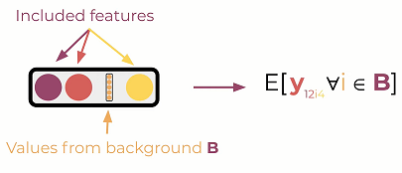
Computation behind Kernel shap
In order to reduce the Shapley value computation complexity, a method call KernelSHAP was introduced to overcome the problem by taking fewer coalitions.
Formulate as Weighted linear regression such that each feature is assigned a coefficient
Different choice of weighting assigned to each datapoint
Solution to the weighted linear regression is such that the coefficients are equal to shapley value.

Slide 7
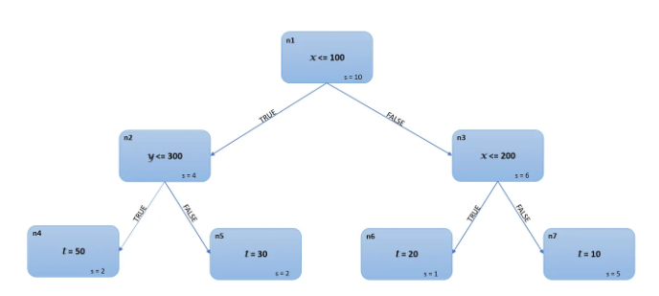
Computation behind Tree shap
Tree SHAP is an algorithm to compute better approx.SHAP values for Trees based models.
ss
Instance X=150,y=75,z=200 → t=20
Combinations(3!=6) | Marginal contributions
x > y > z | Φx1=-3, Φy1=0, Φz1=0
y > z > x | Φx2=-7, Φy2=4, Φz2=0
x > z > y | Φx3=-3, Φy3=0, Φz3=0
z > x > y | Φx4=-3, Φy4=0, Φz4=0
z > y > x | Φx5=-7, Φy5=4, Φz5=0
y > x > z | Φx6=-7, Φy6=4, Φz6=0
Shapley value | x=-5,y=2,z=0
x>y>z sequence
Φx1= 20–23 = -3
Φy1= 20–20 = 0
Φz1= 0
y>z>x sequence
Φy2= 27–23 = 4
Φz2= 0
Φx2= 20–27 = -7
(4/10)*(prediction from left child node n2) + (6/10)*(prediction from right child n3)
Prediction from n2 = 50(y is available) ; n3 = (1/6)*20 + (5/6)*10= 70/6
Therefore, (4/10)*50 + (6/10)*(70/6) = 27 → 27-23 = 4 = Φy2
Final prediction → 23 -5 +2 + 0 = 20
The base value of the prediction in the absence of any information on independent variables is 23; knowing x=150 decreased the prediction by 5 and knowing y = 75 increased the prediction by 2 giving a final prediction of 20. Knowing z = 200 had no impact on the model prediction.

Slide 8
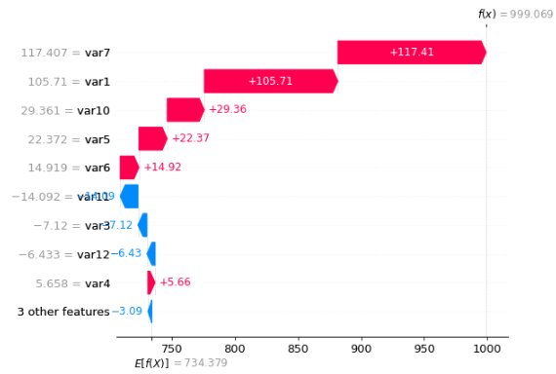
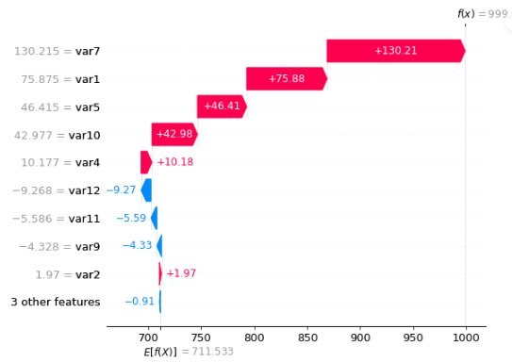
Interpretation – Shapley values using Kernel shap vs Tree shap
TREE SHAP
KERNEL SHAP

Slide 9
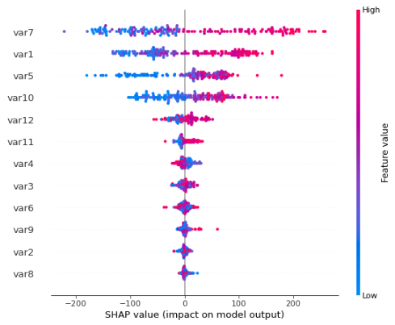
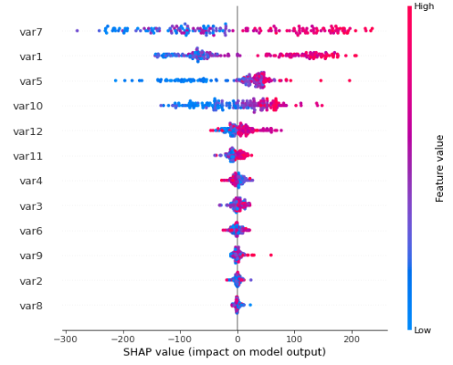
Variable importance and Relationship (Kernel vs Tree Shap)
Variables are arranged in order of importance for prediction.
Inferences from Beeswarm plots:
In Var7,When the feature value(actual value)
increases the shap value increase too which
shows var7 is contributing in increasing the
prediction.(i.e. Positive correlation between Var7
and the target)
Whereas in Var4 , when the actual value increases the shap value decreases which shows there is weak(less spread to the left) negative correlation between Var4 and Target.
Var8 has has no contribution towards prediction.
KERNEL SHAP
TREE SHAP

Slide 10
Limitations of shap
Model dependency
SHAP values may not be directly comparable between different models.
Interpretation difficulty
SHAP values can become difficult to interpret when large number of features involved.
Model agnostic
Theoretically yes. But practically its not available(packages) to all models.
Feature dependency
Shap calculations assumes features are independent. If there is dependencies it will lead to
unrealistic shap values. How ever tree shap could overcome this.

Slide 11
References:
https://adataodyssey.com/courses/shap-with-python/ (Data odyssey)
https://www.youtube.com/watch?v=IqT551LjKHw(Code emporium)
https://www.youtube.com/watch?v=VB9uV-x0gtg&t=459s (kie)
https://www.youtube.com/watch?v=NBg7YirBTN8 (Ritvik math)
https://towardsdatascience.com/shap-explained-the-way-i-wish-someone-explained-it-to-me-ab81cc69ef30 (medium)
https://www.youtube.com/watch?v=u7Om2joZWYs&t=344s (datascience garage)
https://medium.com/analytics-vidhya/shap-part-3-tree-shap-3af9bcd7cd9b#:~:text=Tree%20SHAP%20is%20an%20algorithm%20to%20compute%20exact%20SHAP%20values,of%20any%20machine%20learning%20model.
Github Link:
https://github.com/bb1810/SHAP-_-Interpreting-models

